Slide 1

Team GOD
By: Sohal Patel, Emily Wantland, Scott Pettyjohn, Nathan Moran, Keegan Foulke, Matthew Jackson

Slide 2
Main Goal & Our Users
We’re creating this site for the following users
Researcher
Student
Industry

Slide 3
Researcher
Create Profile
Can view content
Can Edit/delete user profile
Can RSVP for an event
Can apply for grants
Note: This is only the design phase with dummy content and images.
The whole site is managed through admin panel.

Slide 4
Student
Can view content
Can create/Edit/delete user profile
Can RSVP for events
Industry
Can view content
Can create/Edit/delete user profile
Can RSVP for events

Slide 5
Purpose/Problem
Too many clicks to reach content
Dead links
Poor organization
Outdated design
Limited functionality
Goal: Increase grant revenue

Slide 6
Solution
Redesign website
Increase functionality with new/improved features
Decrease clicks to reach content
Eliminate dead links

Slide 7
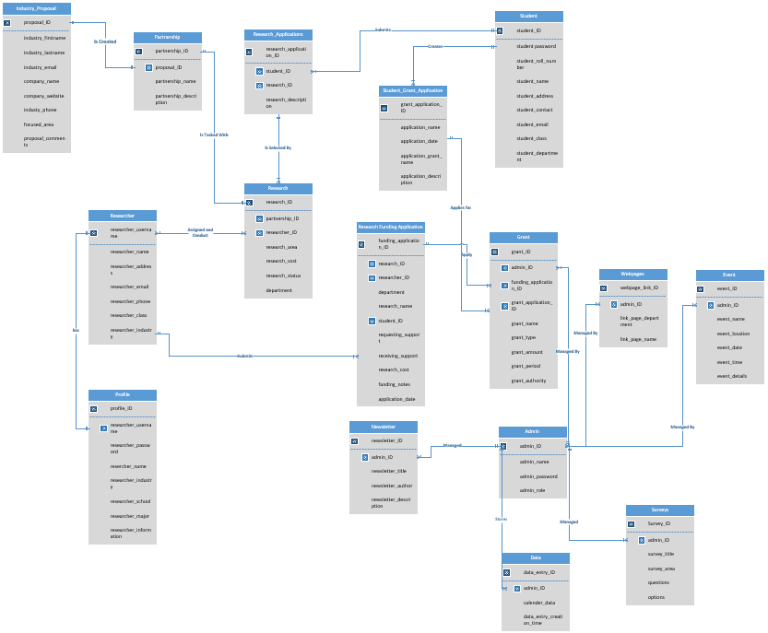
Full ERD

Slide 8
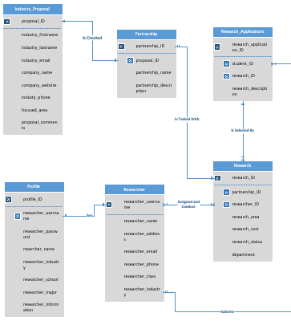
Research
Research

Slide 9
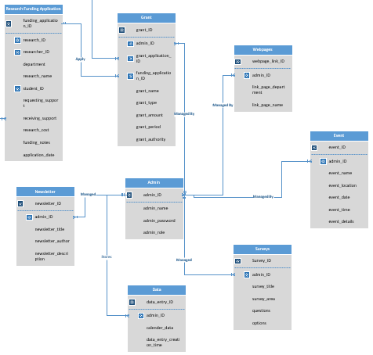
Admin

Slide 10
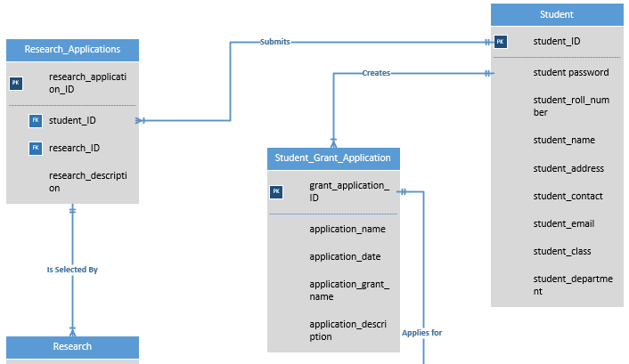
Student

Slide 11
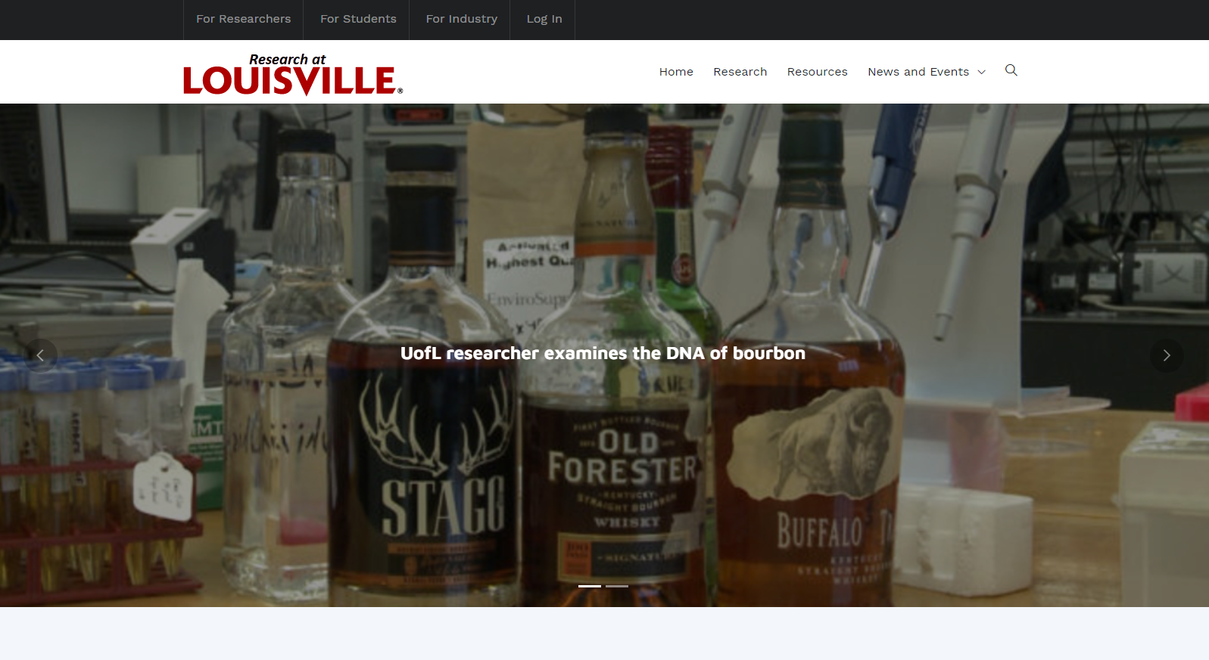
Home Section 1

Slide 12
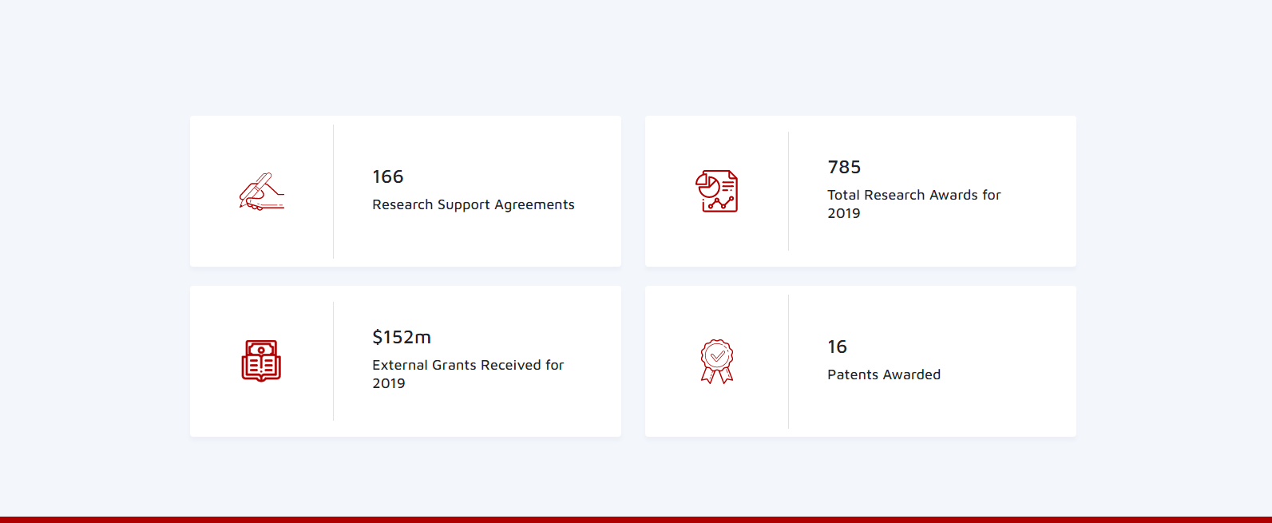
Home Section 2

Slide 13
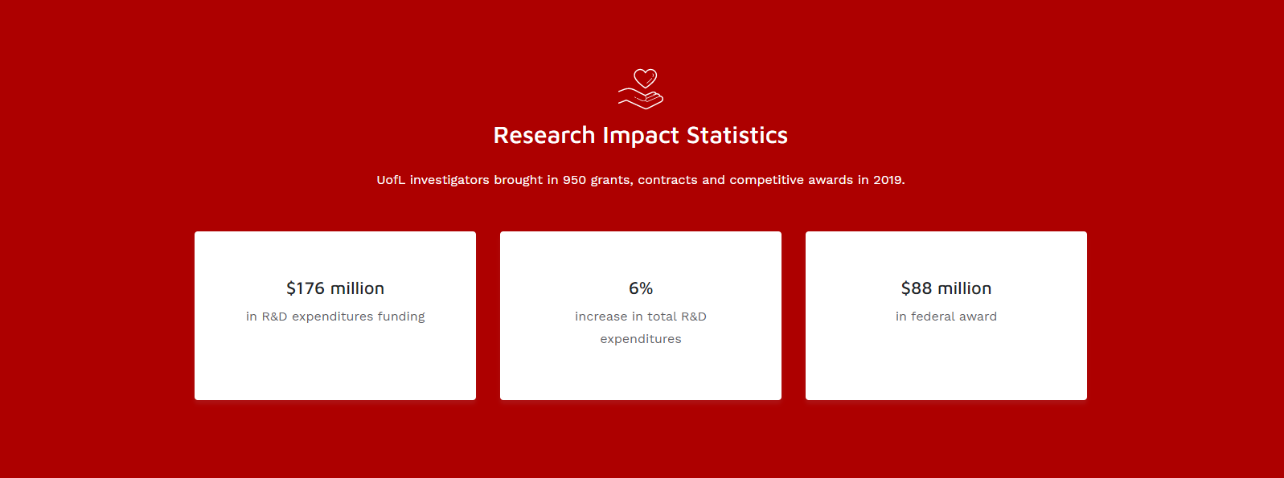
Home Section 3

Slide 14
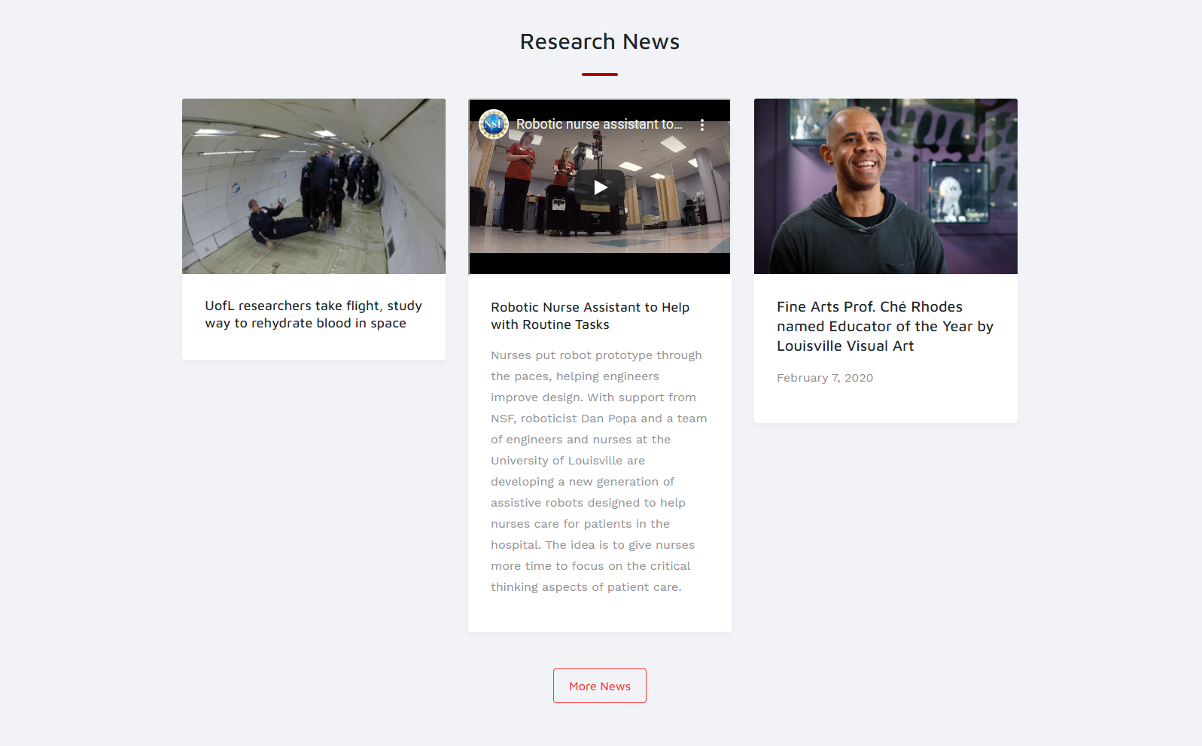
Home Section 4

Slide 15
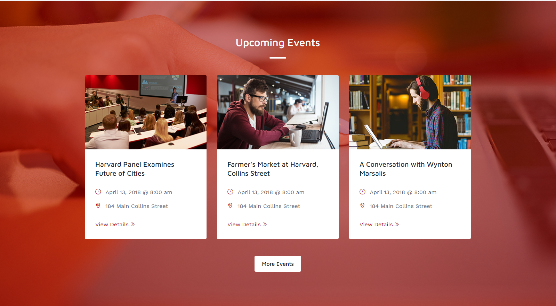
Home Section 5

Slide 16
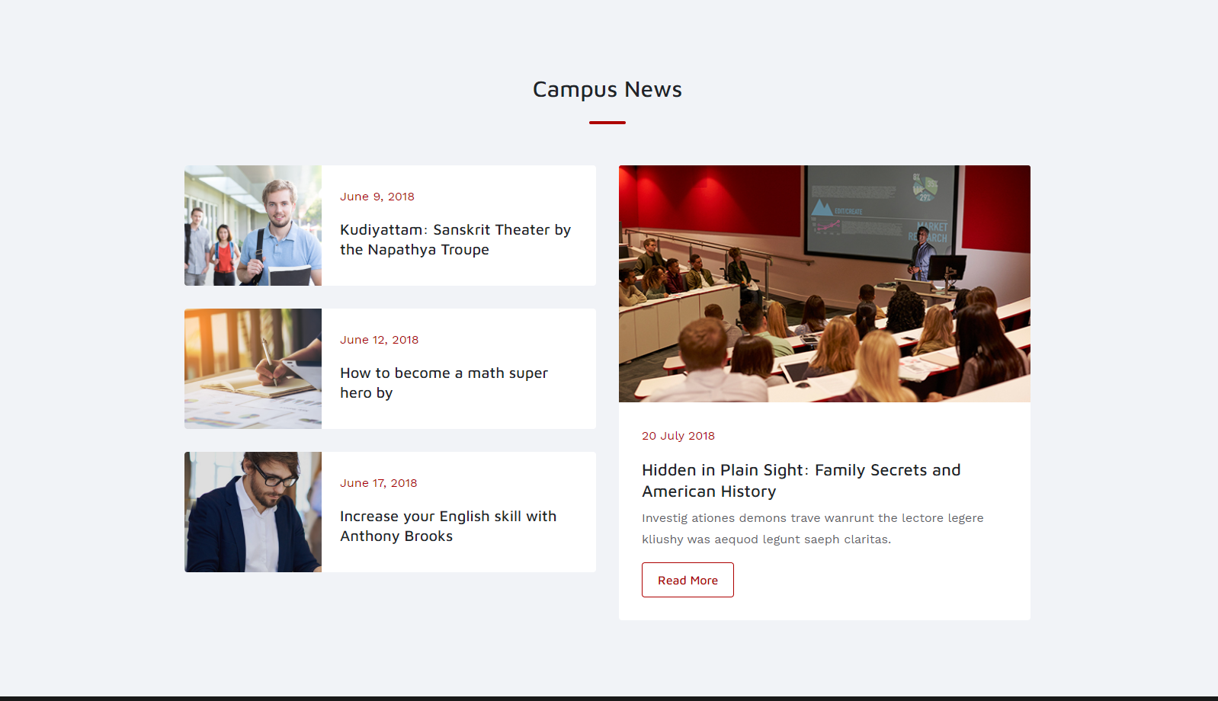
Home Section 6

Slide 17
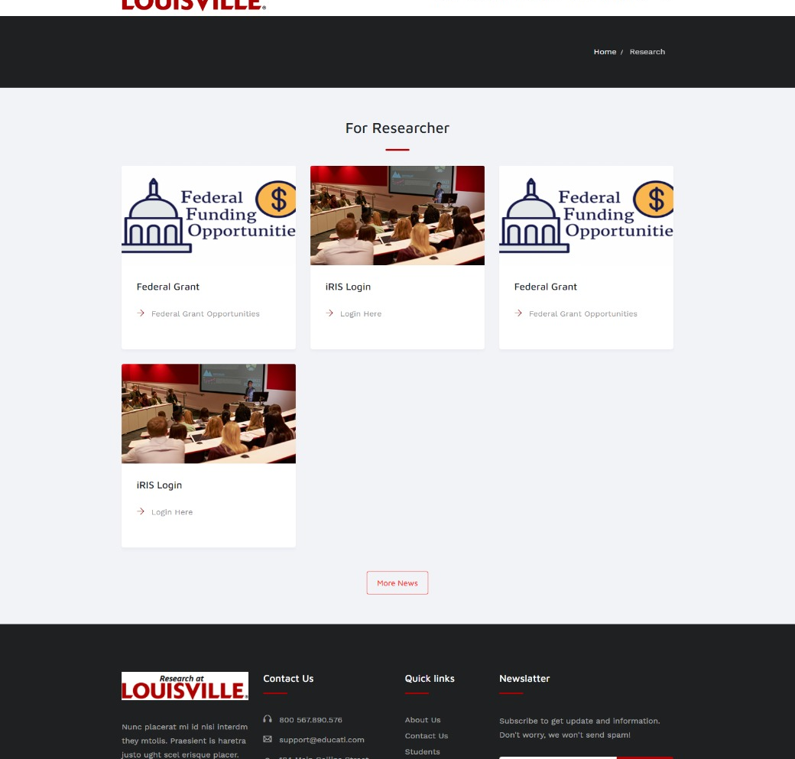
Researcher Page
Easily Managed through Admin Panel.
Only Design
Used Dummy Content
Can Easily Add/ Remove any section

Slide 18
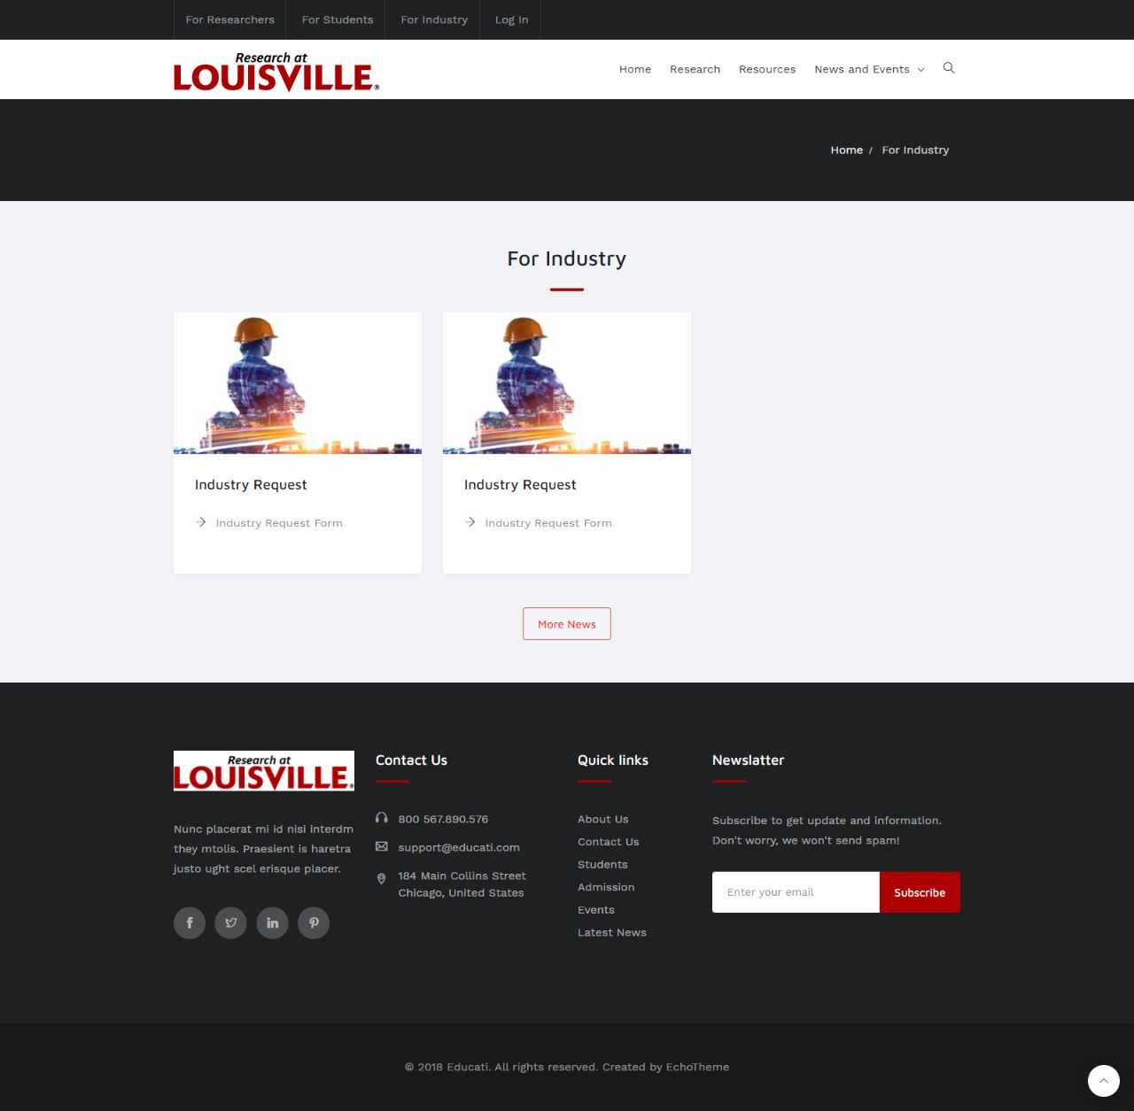
Industry Page
Easily Managed through Admin Panel.
Only Design
Used Dummy Content
Can Easily Add/ Remove any section

Slide 19
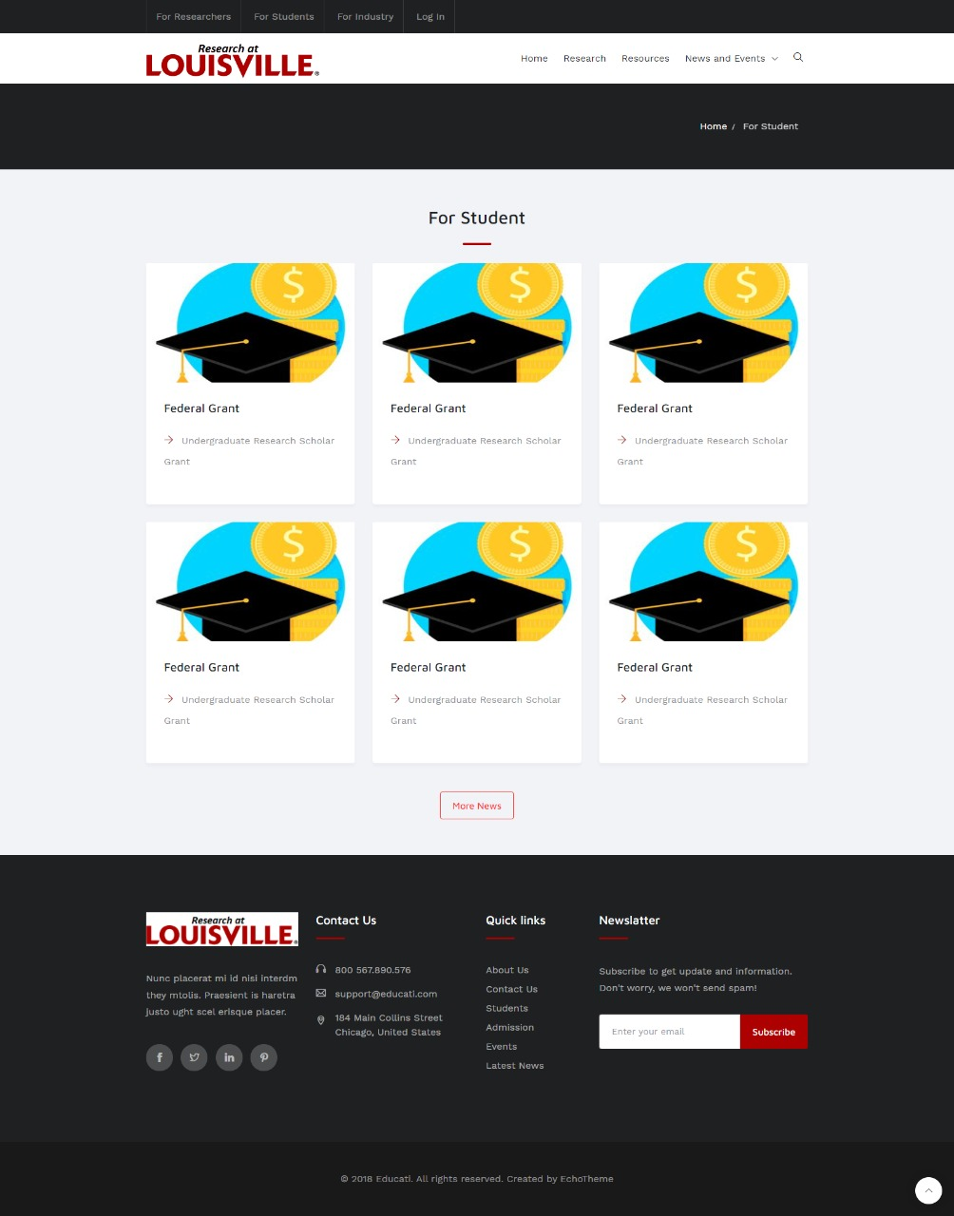
Student Page
Easily Managed through Admin Panel.
Only Design
Used Dummy Content
Can Easily Add/ Remove any section

Slide 20
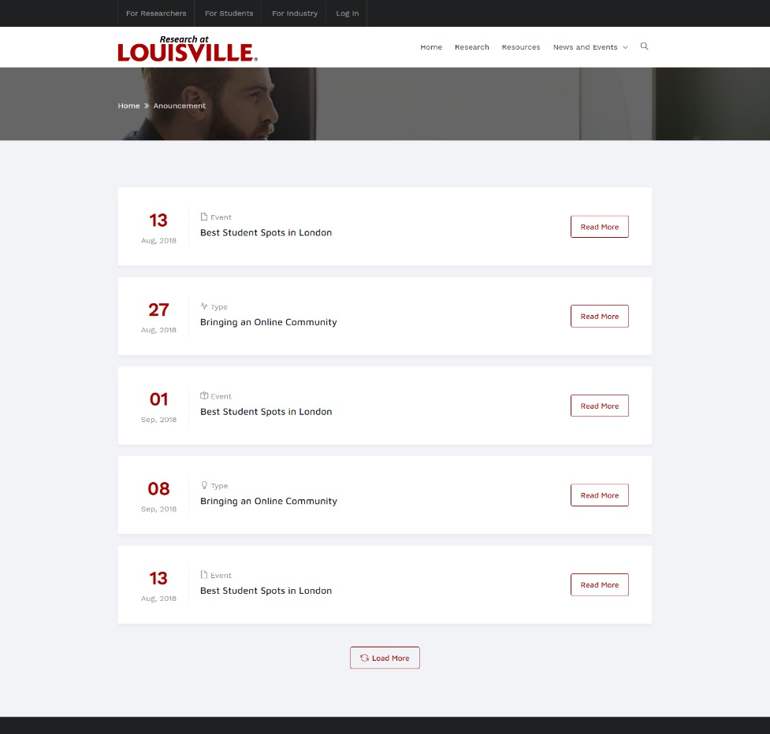
Announcement Page

Slide 21
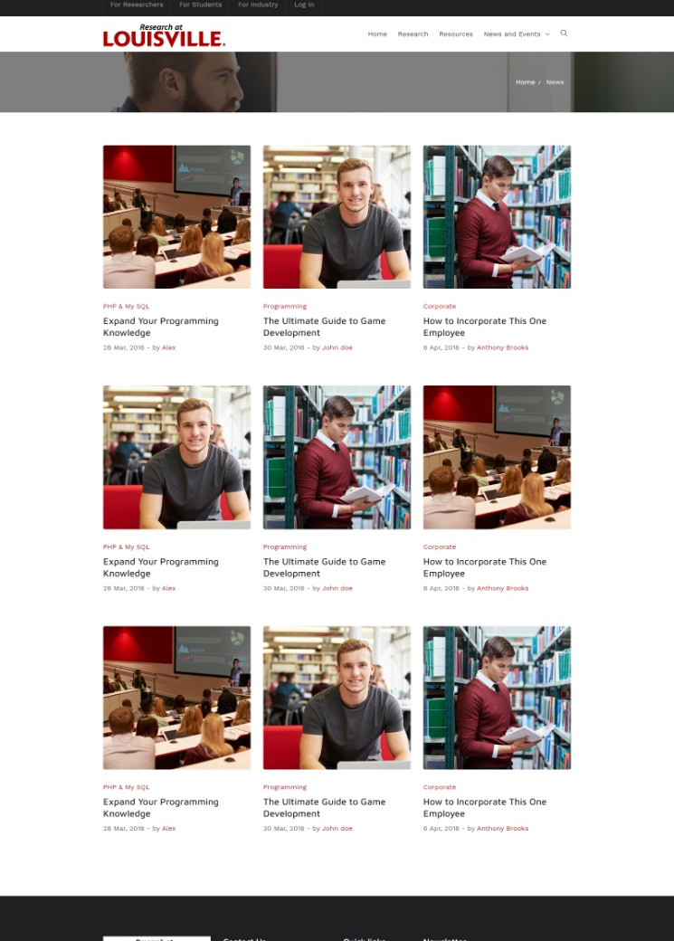
News Page

Slide 22
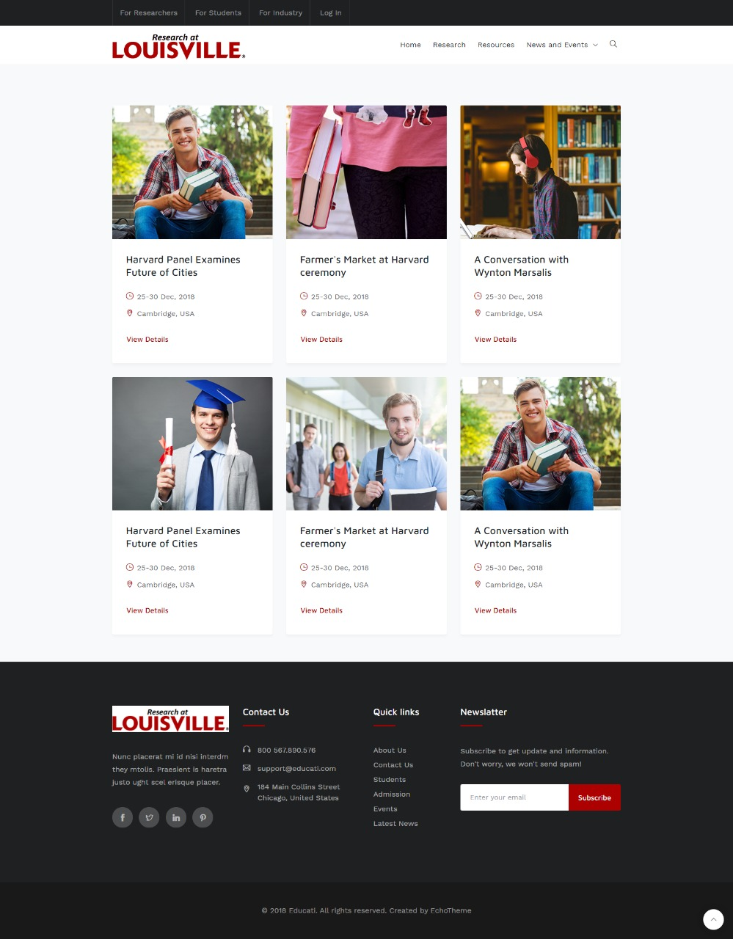
Event Page

Slide 23
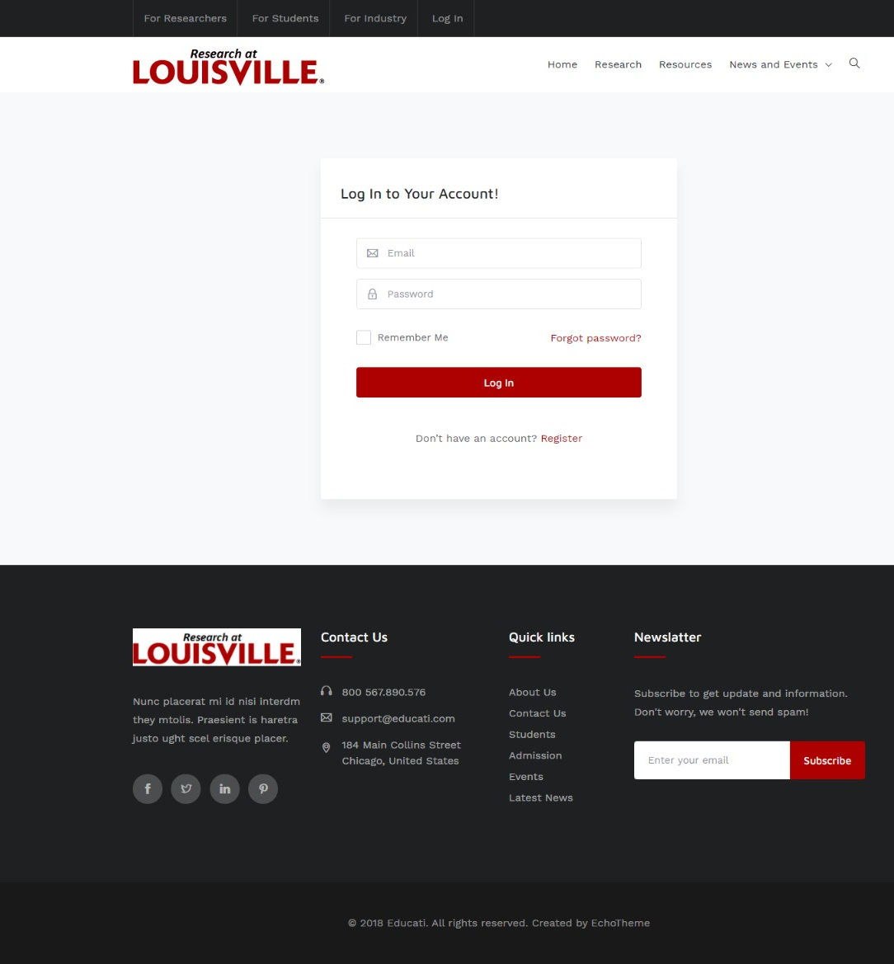
Login Page

Slide 24
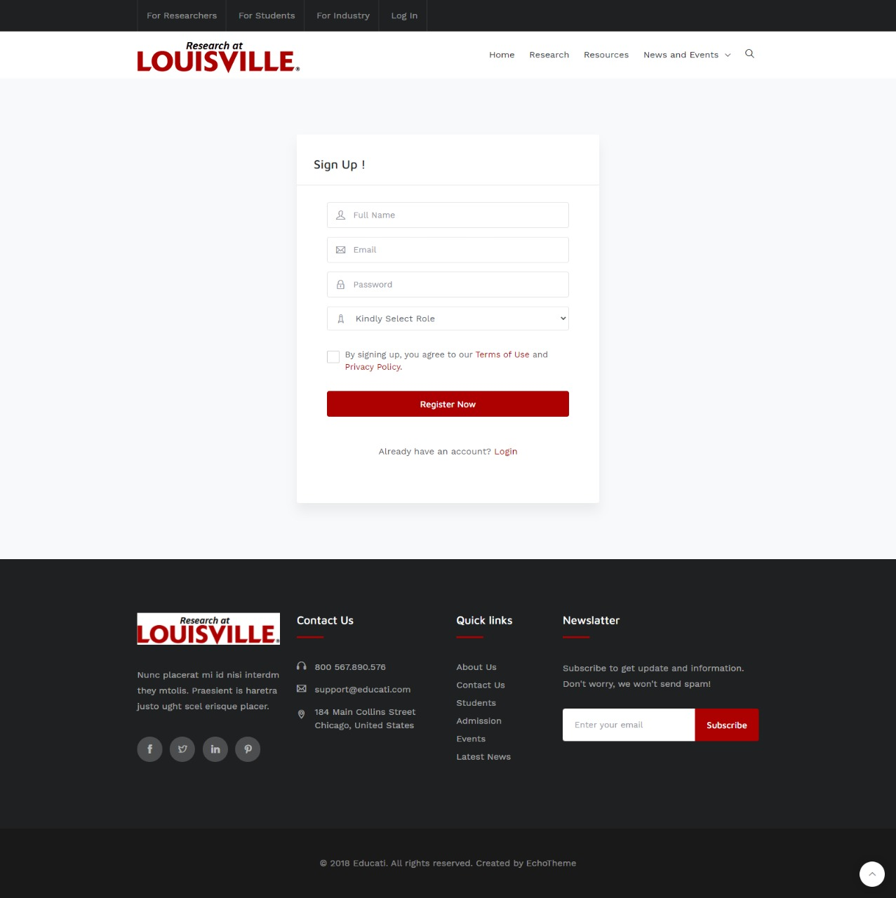
Signup Page

Slide 25

Reset Password Page

Slide 26
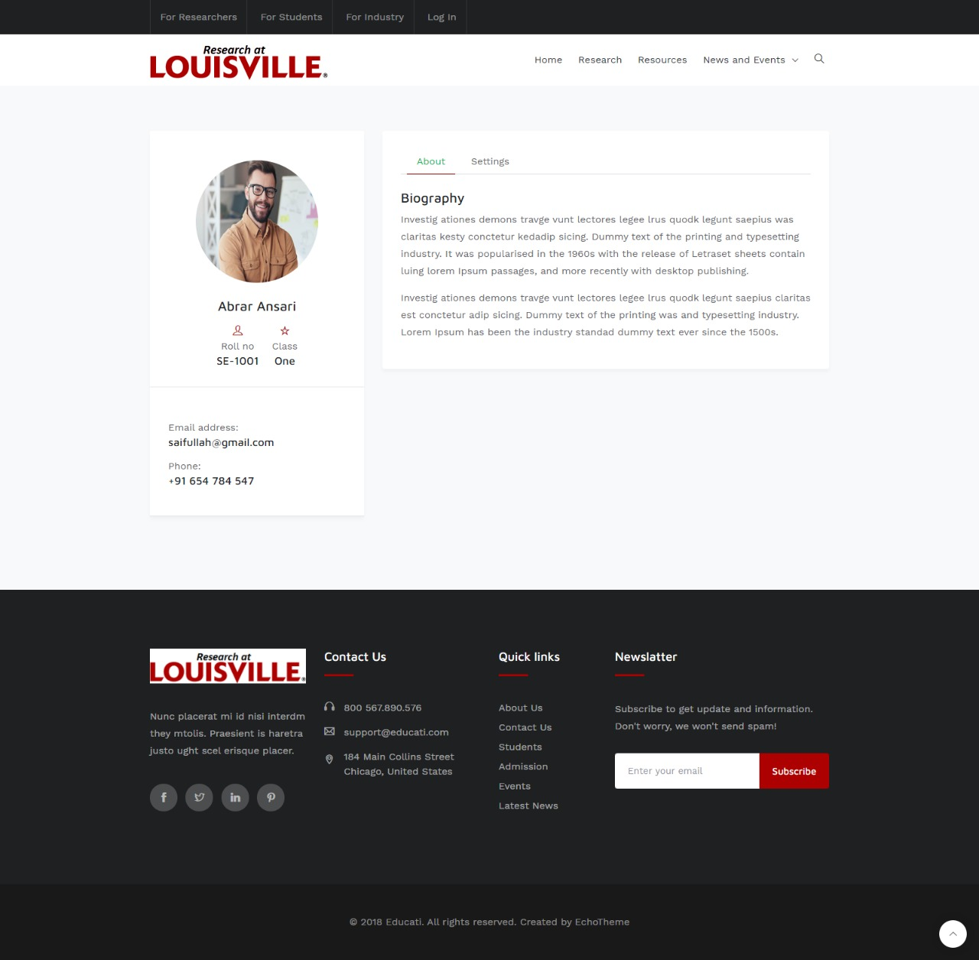
User profile Page

Slide 27
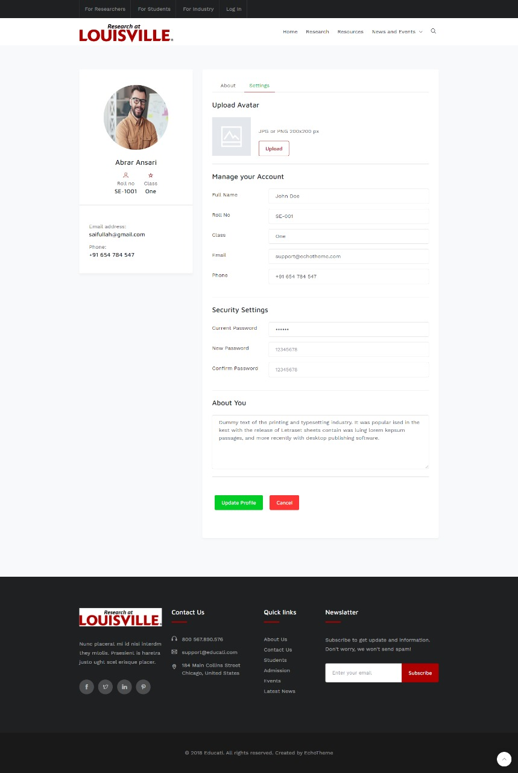
Profile Editing Page

Slide 28

Thank you

